Slide 1

Dhirubhai Ambani institute of Information & Communication Technology
Software Engineering – IT632
Arham Institute Management System
By
Team-04
Battalion 404

Slide 2
Problem
The institution doesn’t have any system to maintain their daily activities
Loss of data
Difficulty in generating manual question paper frequently
Institution has to be depended on other exam portals to conduct online exam for practice
Difficulty in managing every student’s result and analyse it

Slide 3
Problem statement: Solution
“Develop a system that can generate question paper and conduct online exam as well as can manage the institution’s data and manipulate it as desired”
Why this system?
This system can generate the question paper in two ways-custom and random
The faculty can conduct online exam of the question paper created
Student’s attendance can be recorded using this system
Details regarding students, faculties and TA/tutors can be stored
Fees of the students and salary of the faculties can be recorded

Slide 4
Continue…
Results of the exam taken is generated automatically and can be used for analytical purpose
The system is capable of making announcements to students
Faculties can have their respective to-do list

Slide 5
Team members
Student ID | Name
201912003 | Archi Shah
201912012 | Raj Shah
201912025 | Smit Shah
201912031 | Rahul Mahrsee
201912054 | Jainam Shah
201912059 | Deep Bhavsar
201912079 | Priyanshi Rathod
201912093 | Naika Bhatt
201912105 | Vatsal Mehta
201912116 | Venish Shiyani

Slide 6
Pre Development Phase
Feasibility study
Technical feasibility
Economical feasibility
Operational feasibility
Main entities
Admin/Owner
Faculty
Student
TA/Tutor

Slide 7
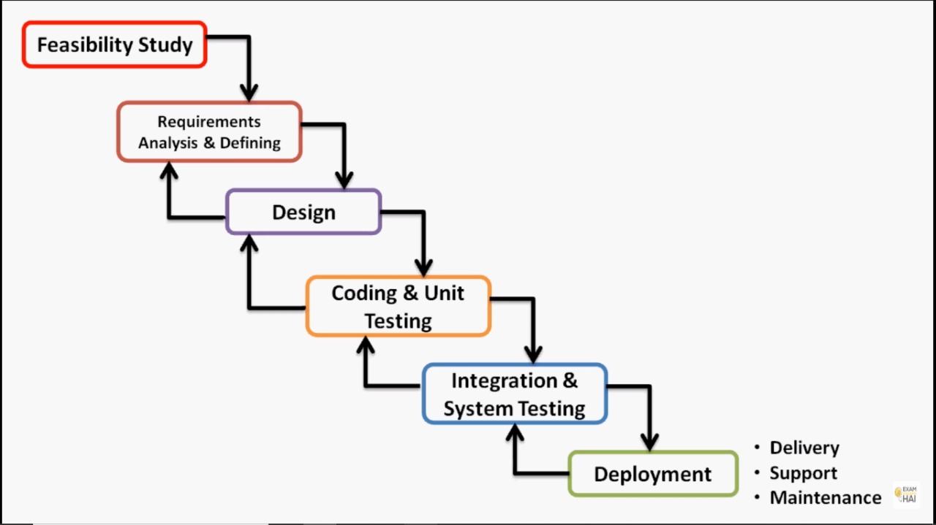
Software Process Model used
Iterative waterfall model:

Slide 8
Requirement Gathering :
Requirements were gathered by Face-to-Face Interview and sometimes Telephonic Conversation with respective stakeholders.
Requirement Analysis:
System Requirement Specifications (SRS)
Version_1.0
Version_2.0
Review of Requirement Phase:
Review Report

Slide 9
Planning :
The time estimation and risk identification is done to avoid unforeseen situations
Following are the documents:
Gantt Chart
Project Plan Estimation
Risk Management Plan
Software Quality Assurance

Slide 10
Designing
Designing phase is the first step in moving from problem domain to solution domain. Designing is the process to transform user requirements into suitable form, which helps the programmer in software coding and implementation.
Design Document

Slide 11
Coding and Unit testing:
Technologies used:
Front-End : Angular 9
Back-End: Node.js (Express) , MySQL.
Unit Testing
Unit Testing Report
Source code:
Github Links
Admin - https://github.com/raj2399/Arham_Education_Admin_Master
Student - https://github.com/jainamdshah3998/Arham_Student
Backend - https://github.com/raj2399/Arham_Education_backend_Master
Web Site That we have hosted :
Cloud Platforms
Hostinger.in
Amazon Web Services
http://admin.handsontech.in
ID : deepbhavsar9@gmail.com Password : deep9699
http:// student.handsontech.in
ID : jalajmehta.jm@gmail.com Password : 1234

Slide 12
Integration And Testing:
Test Plan :
Test plans
Test report (Integration) :
Test reports
Testing & Integration Phase :
Testing & Integration
System Review Report

Slide 13
Future Scope
Solution of each question can be provided which can help students in clearing their doubts after the exam is given
The faculty can be provided with functionality of selecting each and every question manually
The institution can be provided with an online payment gateway for salary and fees payment

Slide 14
Documents we have made :-
Feasibility Study
Software Requirement specification | Unit Testing Report
Project Plan Estimation | Learning Document
Design Document | System Test Plan
Gantt Chart | Integration Test Report
Risk Management Plan | User Manual
Software Quality Assurance | Final Report

Slide 15
Thank You

